Slide 1



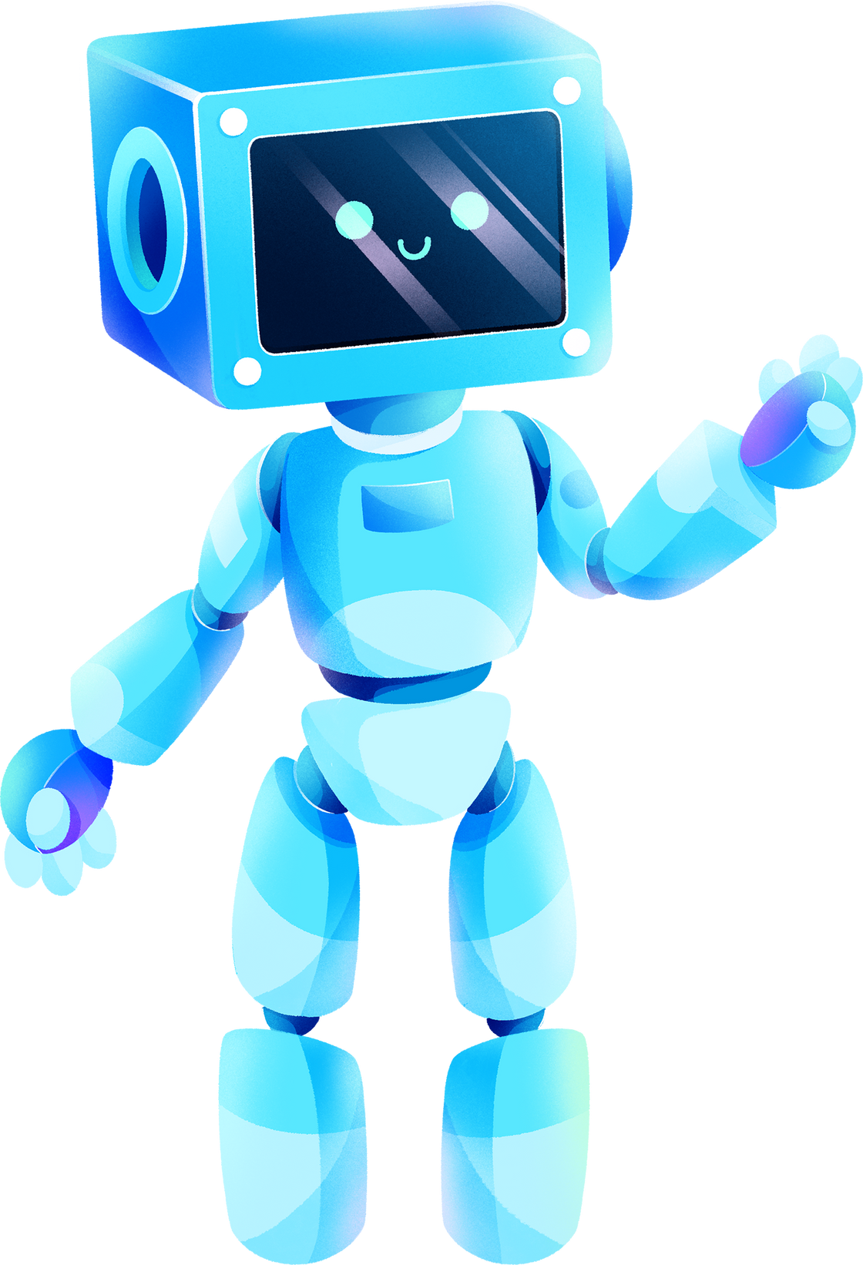

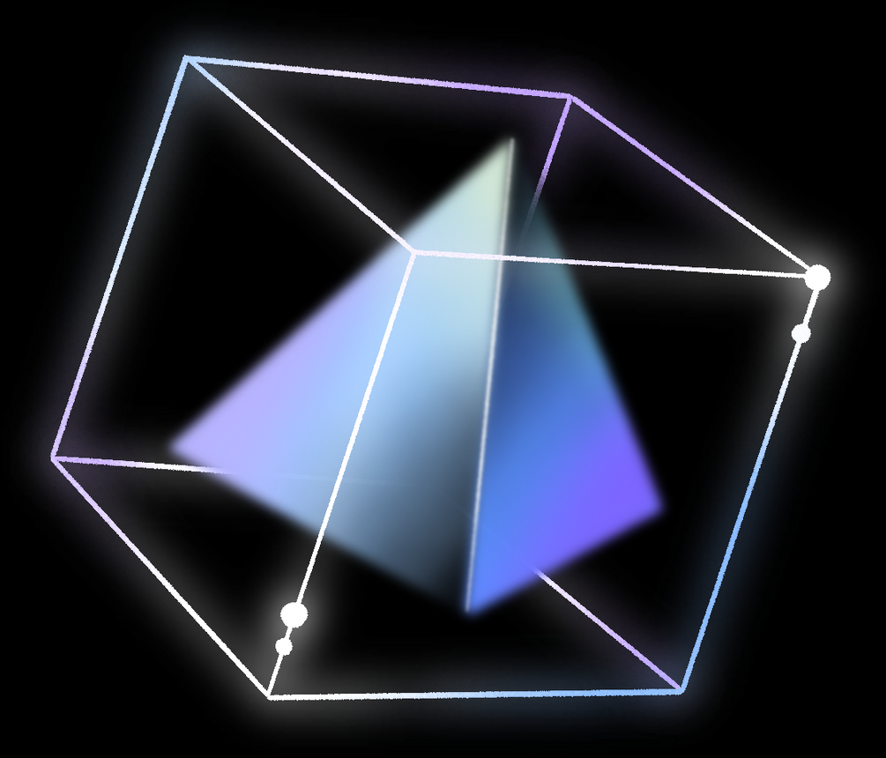
4TH YEAR
PROJECT
CHATBOT INTERGRATED WITH IT TICKETING SYSTEM
By x004989 Ron Coveney

Slide 2


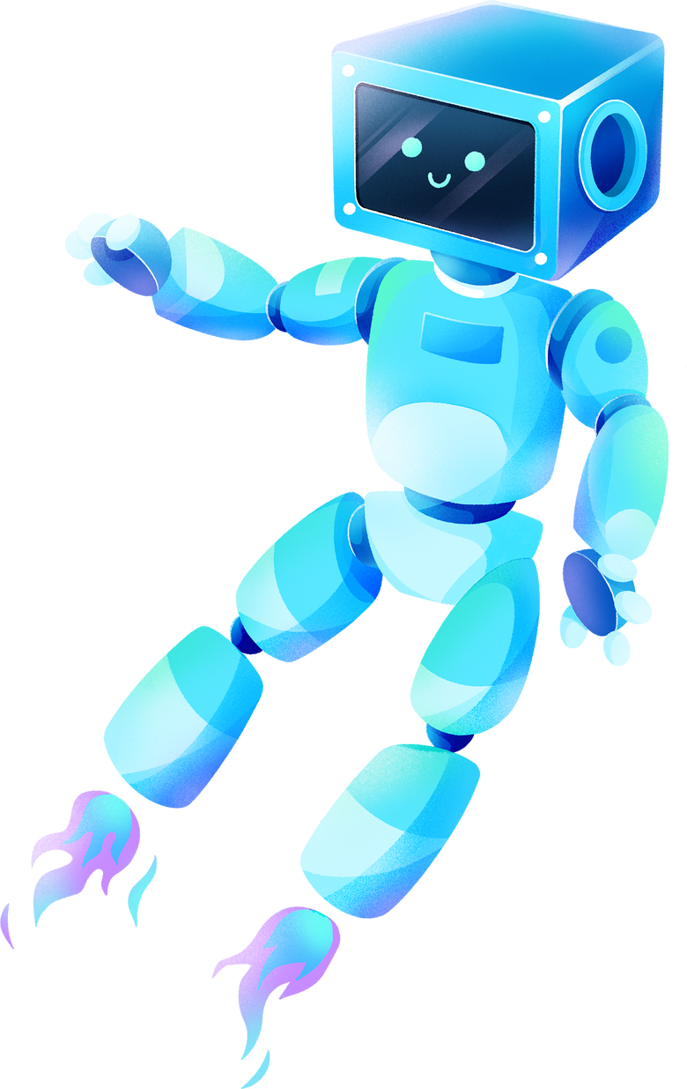



PROJECT SCOPE
Ticket Management
Create and Manage IT Tickets by interacting with a third-party IT ticketing system
User Interaction
Handle queries and provide solutions to IT Issues thereby freeing up time and resources
Automation
Automate ticket creation and escalation to human agents when necessary
Cloud Based
Cloud based structure to allow for scaling

Slide 3

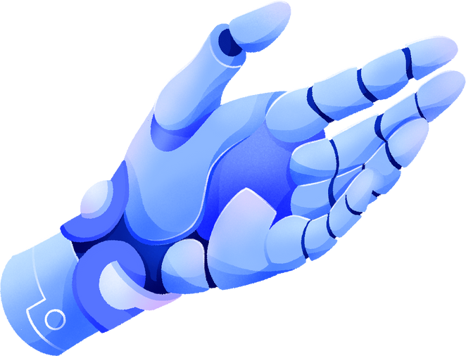

WORK TO DATE
HISTORY AND PROGRESSION OF CHATBOT TECH RESEARCHED
PURPOSE AND SCOPE OF PROJECT DECIDED UPON
RESEARCH CARRIED ON SCALABILITY TECH TO BE USED
ISSUES ENCOUNTERD
SERVER CREATION
WORKING WITH FLASK FOR FIRST TIME

Slide 4




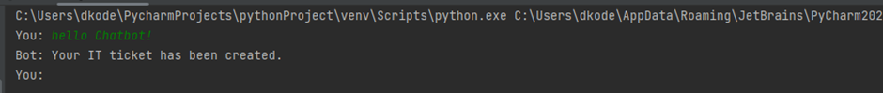
PROOF OF CONCEPT
I wanted to prove that I could generate a connection between the chat bot and a server that represented the IT Ticketing system
01
NEXT STEP
02
I want to research Natural Language Processing (NLP) and to be able to integrate that into the chatbot that I have created.
I also want to explore if I can host the bot on Azure to allow for future scalability.

